Slide 1
#HACKATHON Team Code For Coffee
#JOTB17 @JOTB17

Slide 2
You are organizing a great conference?
JOTB17

Slide 3

You feel like “A job well done!”
JOTB17

Slide 4

Feeling really good!
JOTB17

Slide 5
???
JOTB17
But all of sudden you feel …

Slide 6
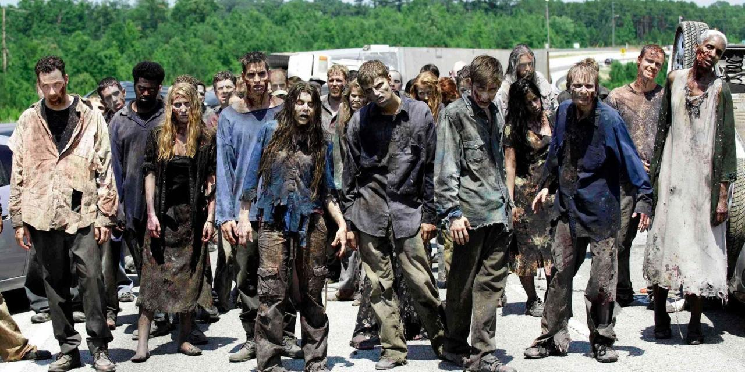
… something is wrong …
JOTB17

Slide 7
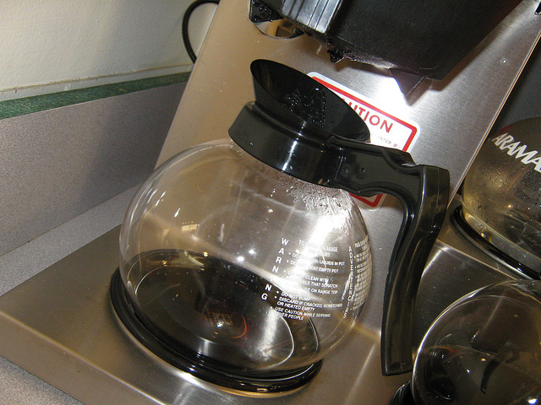
“I am not a zombie, need coffee!”
JOTB17

Slide 8



We can help! We just need …
JOTB17
Amazon AWS Dash
Philipps Hue
Twitter

Slide 9
… and the power of VALO!
JOTB17
VALO

Slide 10
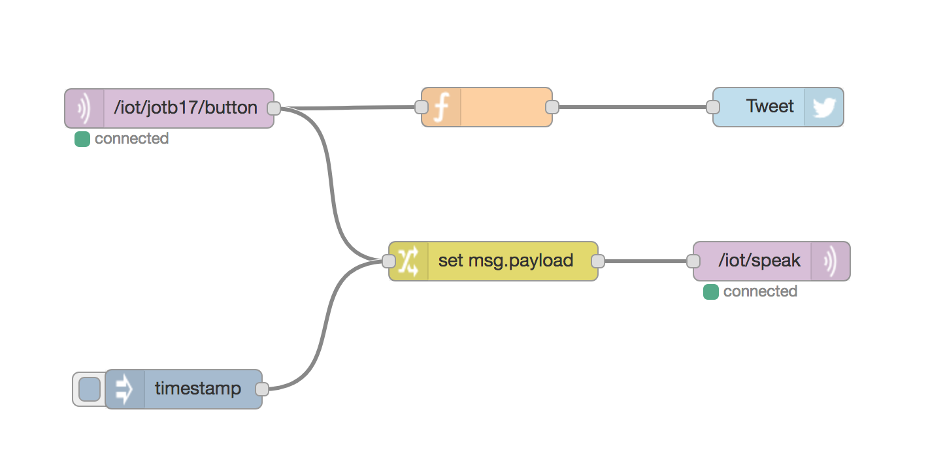


Using the button for notification
JOTB17

Slide 11


TITLE
JOTB17
#morecoffee
Twitter Stream
@JOTBHelp
#morecoffee
#bringingcoffee
#coffeerefilled

Slide 12
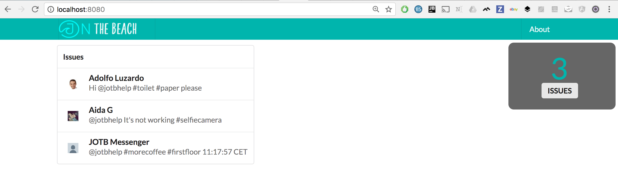
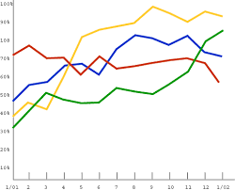
Real-Time Dashboard
JOTB17
3.8 min
Average

Slide 13
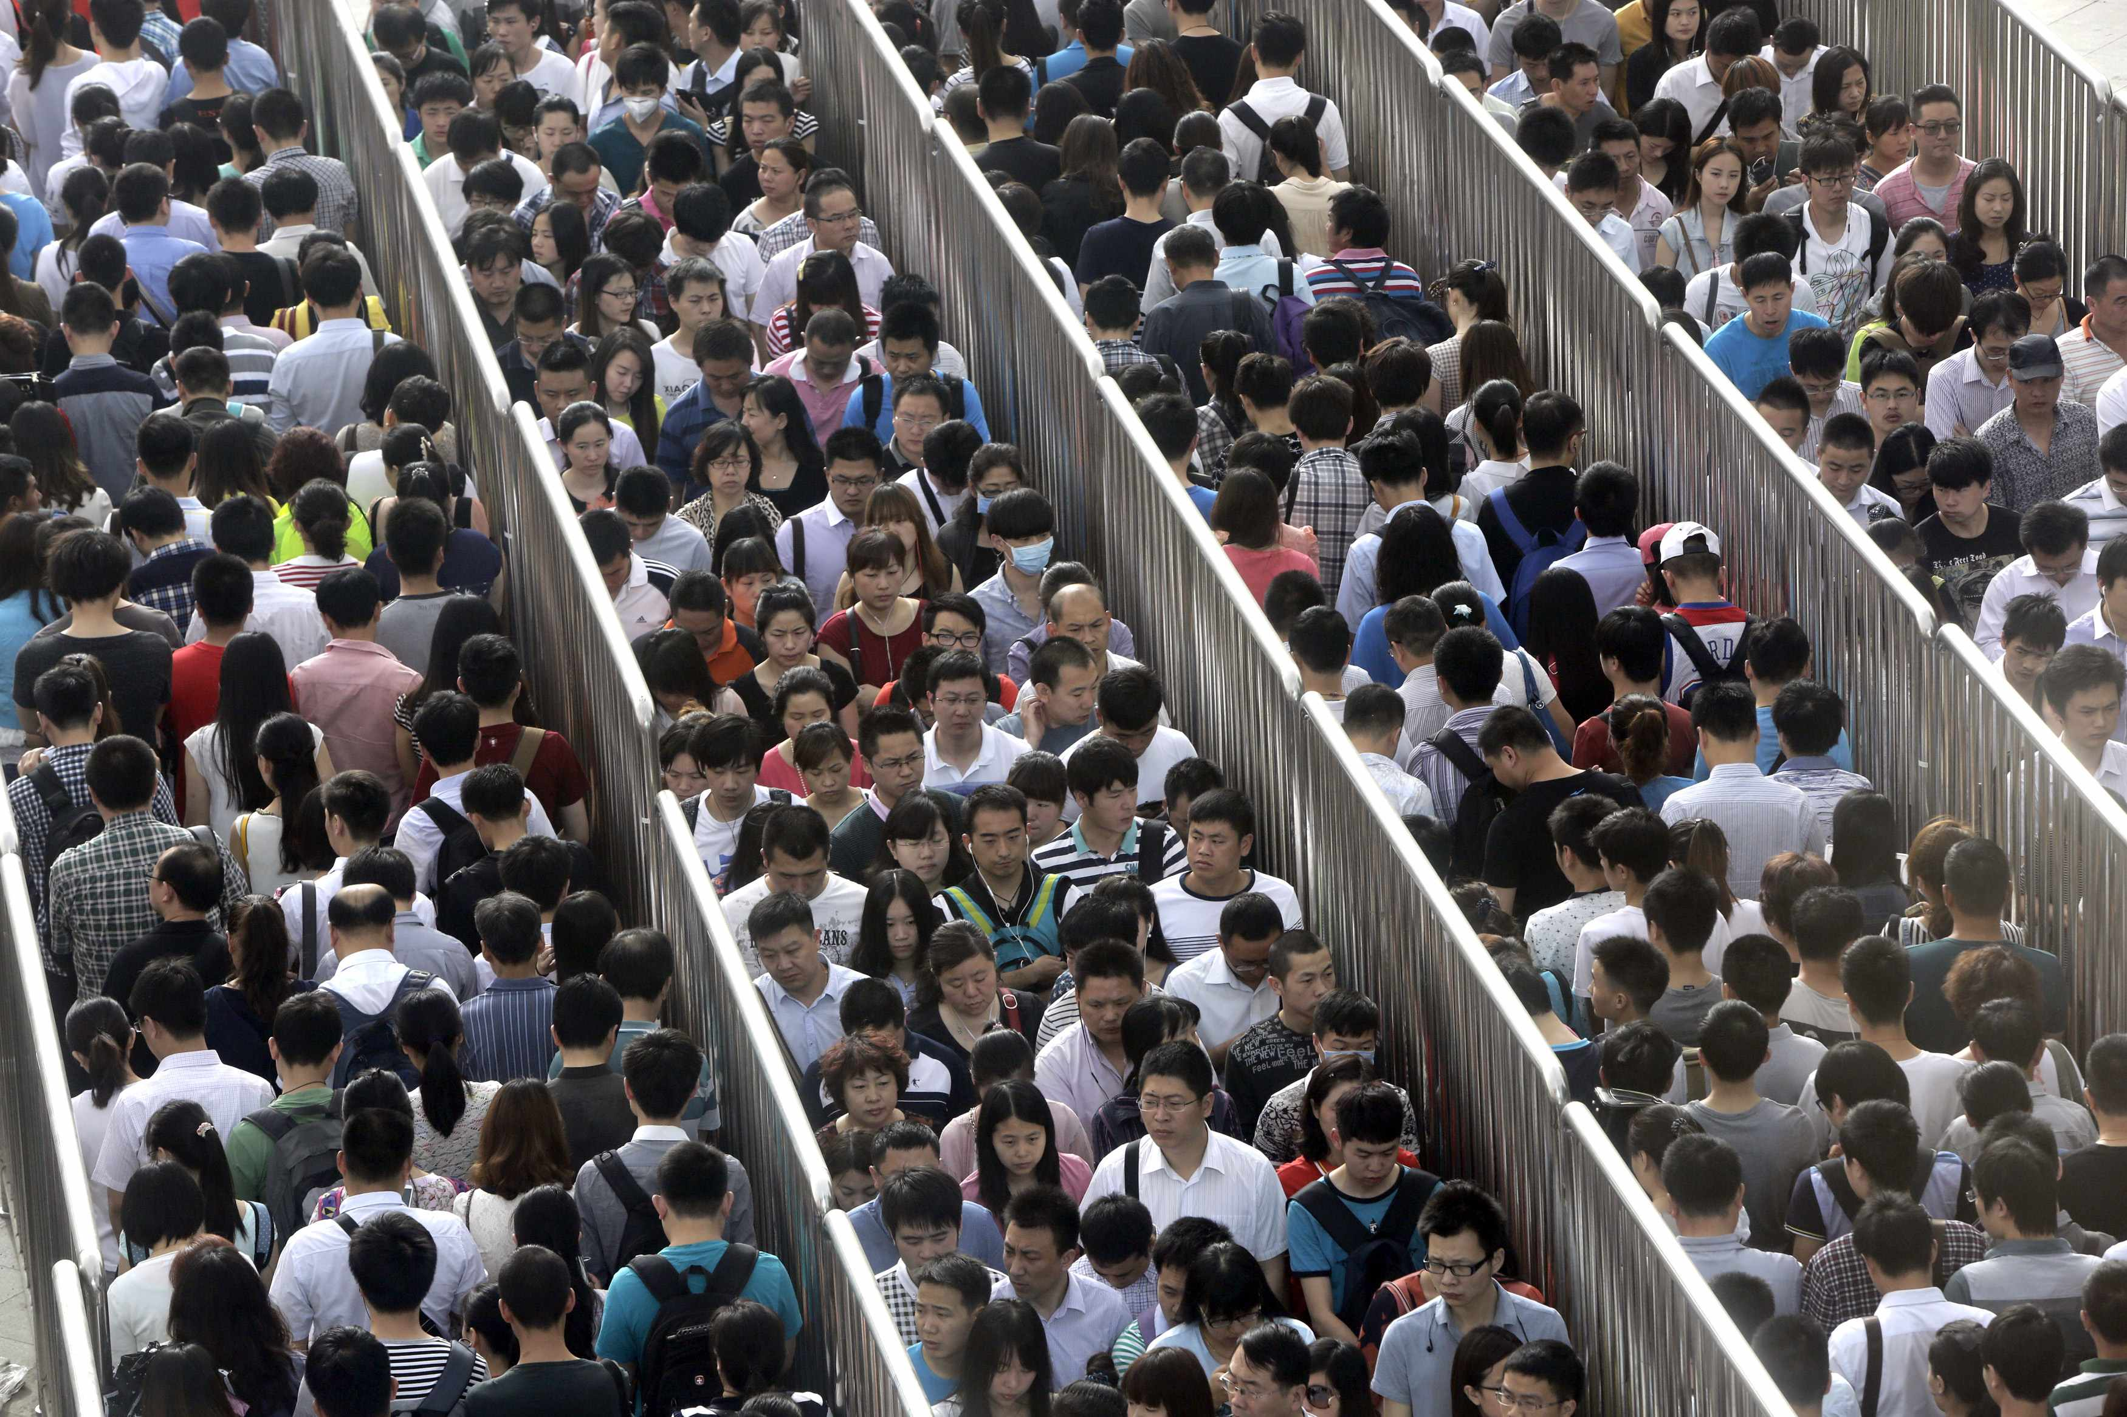
Stuck in the queue?
JOTB17
@JOTBHelp
#registerme

Slide 14
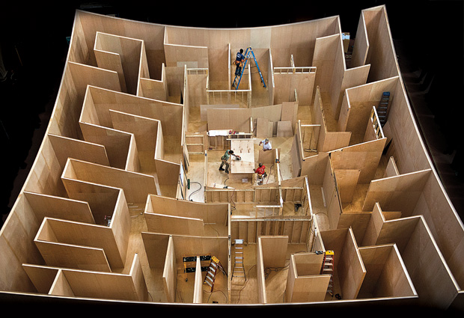
Lost in the the building?
JOTB17
@JOTBHelp
#whereami

Slide 15
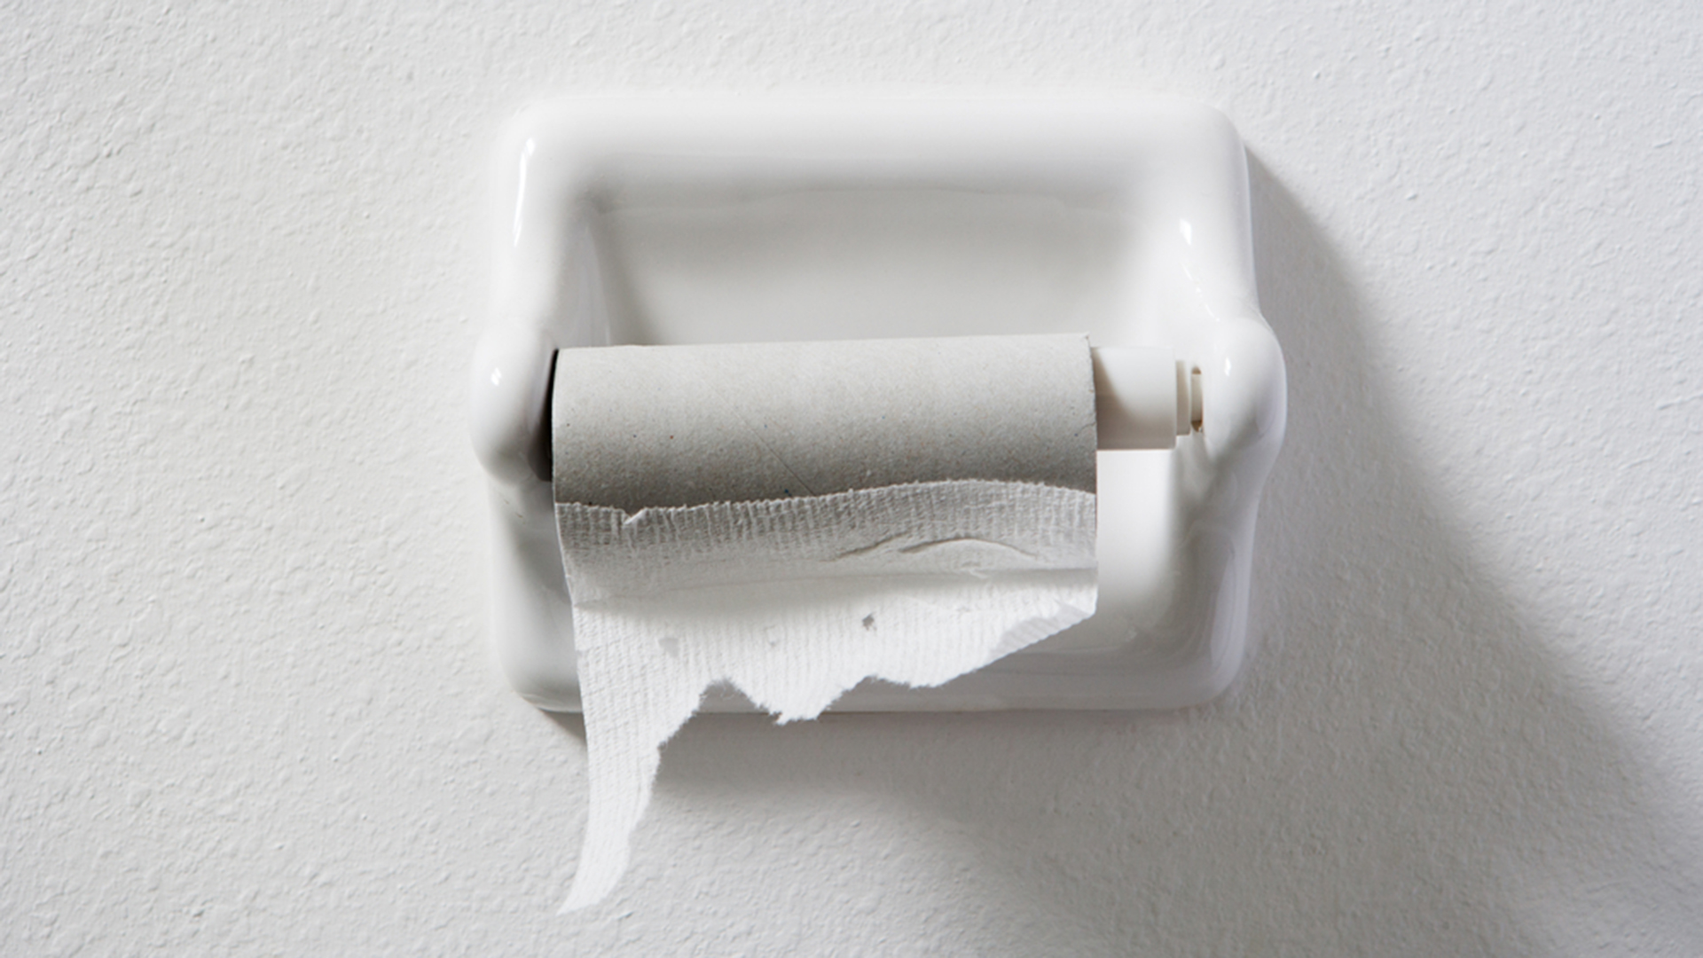
Stuck on the toilet?
JOTB17
@JOTBHelp
#needpaper

Slide 16
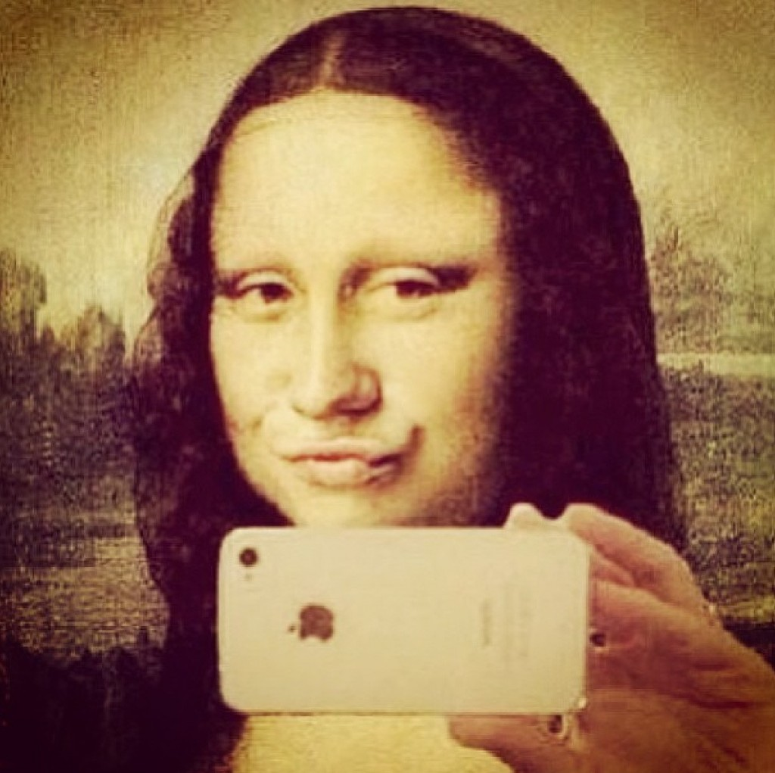
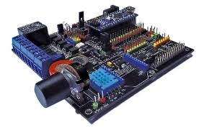
Want to send greetings?
JOTB17
@JOTB17
#greetings

Slide 17

Want to give feedback?
JOTB17
@JOTB17
#nicetalk

Slide 18
TITLE
JOTB17
….text…

Slide 19
TITLE
JOTB17
….text…

Slide 20
Thank you!

